Slide 1

Sensor Kit (Kit 1)
ZAS Robotics Training

Slide 2



Sensor Kit - Contents
Sensor Kit Components
Sensor Creative Board

Slide 3




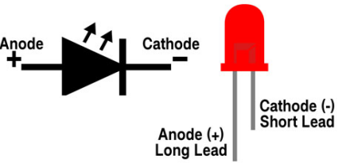
SFL02: MULTIPLE LED CONTROL(TRAFFIC LIGHT SEQUENCE)

Slide 4
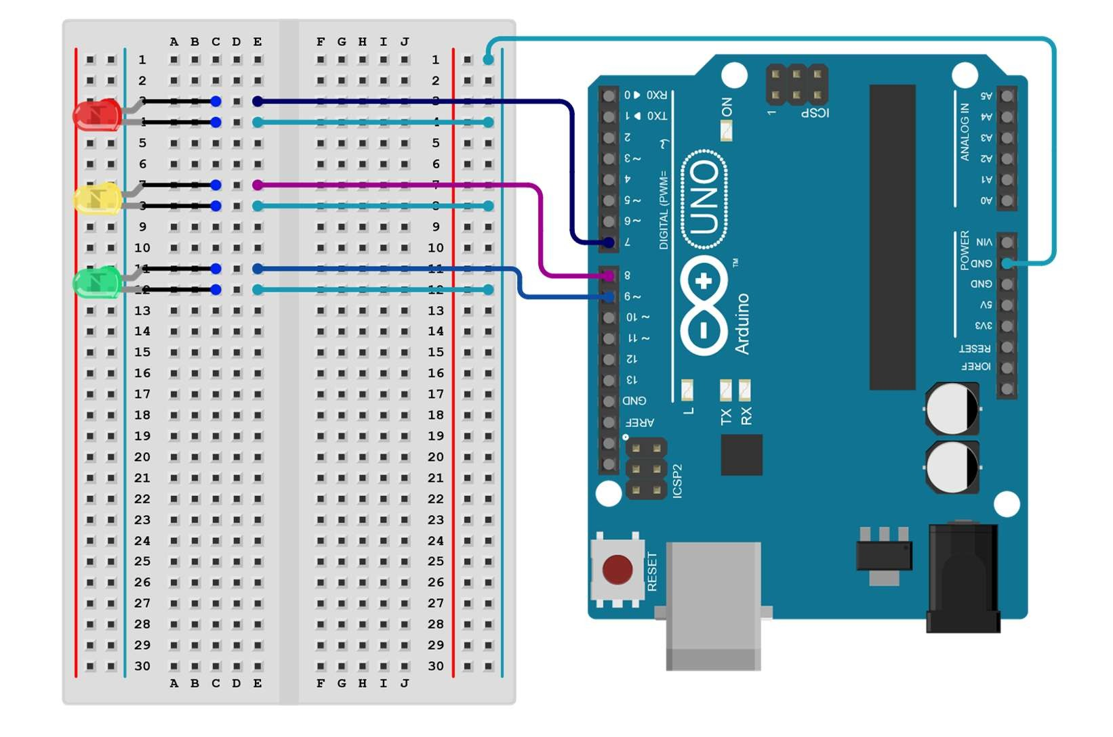
SFL02: MULTIPLE LED CONTROL(TRAFFIC LIGHT SEQUENCE)
Connections:
Arduino pins | LEDs(Breadboard)
GND | GND(light blue lines) Short ends
Digital pin(7,9,10) | LEDs (Long end) Red-9 yellow-7 Green-10

Slide 5
SFL02: MULTIPLE LED CONTROL(TRAFFIC LIGHT SEQUENCE)
setup()
• attach LED
RED – PIN9
YELLOW – PIN7
GREEN – PIN10
loop()
  The red light is turned on for 5 seconds.
  The green light is turned on for 5 seconds. The yellow light is turned on for 2 seconds.
The sequence then repeats indefinitely.
Code for Lesson SFL02:
https://github.com/info-zas/zas-robotics-sensors/blob/main/01_FoundationProjects/01_Code/_02_ControllingMultipleLEDs/_02_ControllingMultipleLEDs.ino

Slide 6
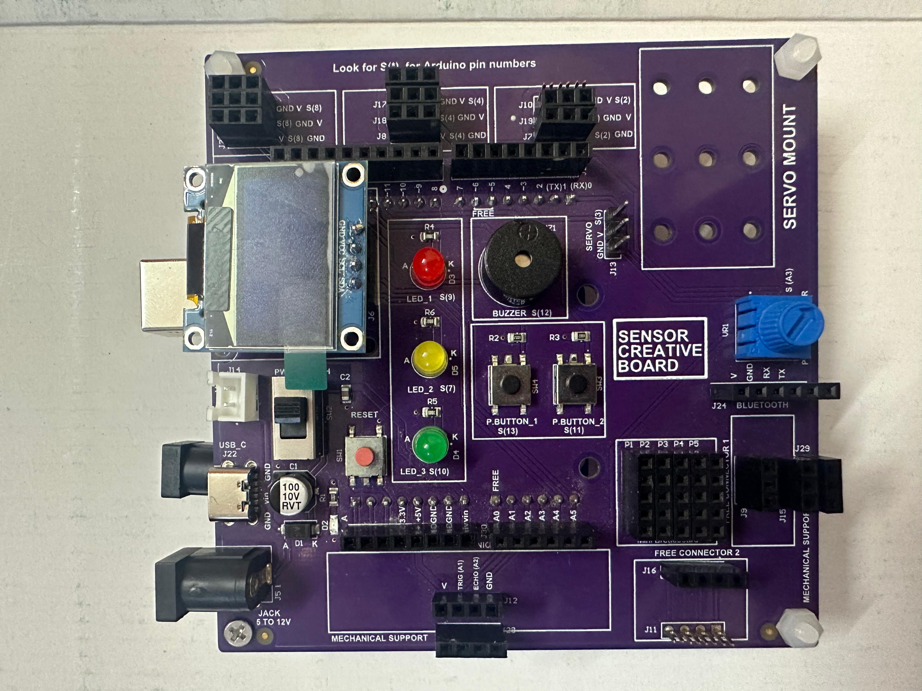
SFL02: MULTIPLE LED CONTROL(TRAFFIC LIGHT SEQUENCE)
The creative board already has built-in LED lights.
These LEDs are pre-connected to Arduino pins.
This setup removes the need for additional wiring.
The design prevents wire clutter and keeps the workspace neat.
It lets users focus more on the project rather than wiring.
Ideal for beginners learning Arduino without hassle.

